Slide 1

Untangling production monitoring
Nik Molnar @nikmd23

Notes:
Introduce myself
We’ve seen huge changes in the way software is built in the past 5ish years: cloud computing, containers, container orchestrators, immutable infrastructure and things like serverless and microservice architectures force us to think about how we solve problems differently – especially because our applications are becoming even more distributed and ephemeral.
So while infrastructure is easier than ever to setup, and our focus on microservices is helping our services to get simpler, these technologies are in fact making systems as a whole more complex.
And complexity, for developers like is us where the challenge lies. Not so much that it’s hard to develop something that’s complex, but more so that it’s difficult to understand and deal with all the various ways that a complex system could fail, and we’re living in a world where failure is inevitable.
So how do we control failure? With quality assurance practices.

Slide 2
Pre Production
Production
- Unit tests
- Regression tests
- Code coverage
- Static analysis
- Integration tests
- Load tests
- Feature flagging
- Traffic shaping
- Monitoring
- Logging
- A/B Testing
- Monitoring
- Logging
- A/B Testing
Deploy
Release
POST Release
Quality Assurance
Notes:
And there are a lot of them:
Walk through the examples…
And these fall into two big buckets: pre-production, and production.
But production actually has several phases to it:
First is deployment, which is getting the new bits into a production like environment, if not production itself.
Then we release it, which is the process of routing live traffic to the new bits
And then, there’s activities that we continue to do, after the release. These are support and reliability activities and things to help us make better decisions for the next version of the product.
Of course this list isn’t complete, but just a few examples. But we see here on this continuum the word test and monitor appear many times. Let’s dive into what these mean:

Slide 3
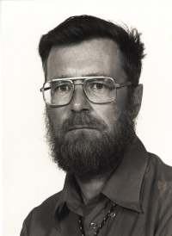
Observability
Monitoring
Testing
Testing can be used very effectively to show the presence of bugs but never to show their absence
Dijkstra
Notes:
The first thing we do to improve the quality of our software it write tests. With test we do a best case effort to verify that a program is correct. If we’re good at writing tests, we might not even be testing that it works, we’re testing that we can’t break it by throwing known failure states at the code.
But, as Dijkstra said…
So, we go into monitoring, which helps us to track failures that are perhaps too difficult to test for so we can understand when we are impacted by them. And really monitoring isn’t that different from testing, it should evolve with the system, just like a test suite evolves with a system.
The monitoring system should be able to tell us what broke, and why. Monitoring provides a good approximation of the health of a system, but monitoring doesn’t prevent failure entirely. But, unfortunately, because our systems are getting so complex, it’s difficult to understand why something breaks. Really, when we say that something is “stable” or “proven” we’re not making a statement that it’s perfect, we’re making a statement that we understand and can mitigate the way that the system fails.
So testing can cover all the failures that are known knowns. Monitoring can help us understand the known unknowns, but what about the unknown unknowns? That’s where the idea of observability comes in.
“Observability”, or you can think of it as debugability, aims to provide highly granular insights into the behavior of systems along with rich context, perfect for debugging purposes. Since we can’t know all the ways that a system could fail, we need a system that can tell us what was happening inside of it so that we can figure out how to fix failures we can’t even dream up yet.
Basically, observability acknowledges that:
- No complex system is ever fully healthy.
- Distributed systems are pathologically unpredictable.
- It’s impossible to predict the myriad states of partial failure various parts of
the system might end up in.
- Failure needs to be embraced at every phase, from system design to implementation,
testing, deployment, and, finally, operation.
- Ease of debugging is a cornerstone for the maintenance and evolution of
robust systems.
Let’s dive into this a little bit more

Slide 4
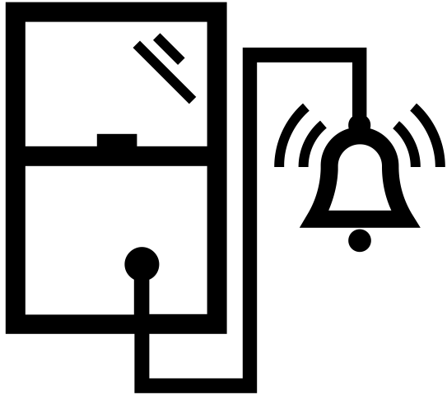

Monitoring
Observability
- Alerting
- Overview
- Debugging
- Profiling
- Dependency analysis
Proactive
Reactive
Ops
Dev
Monitoring vs. Observability
Notes:
Here’s some things we might want out of our system running in production:
I’d group alerting and overview into the monitoring camp, and I’d put all of it into observability.
If you look at this breakdown, you’ll see that the jobs of monitoring traditional would be done by Ops or someone who is on call, but the jobs of observability require domain expertise and engineering intuition to look at the facts presented and understand whats going on.
Furthermore, unlike “monitoring” which is known failure centric, “Observability” doesn’t necessarily have to be closely tied to an outage or a user complaint. It can be used as a way to better understand system performance and behavior, even during the what can be perceived as “normal” operation of a system.
Another way to look at it is that monitoring is always proactive, you have to set it up to get value out of it, and observability is reactive, you dive into the data when you have a question.
I see the difference like a well rounded security system:
Security camera is Observability - so you can ask a question later that you don’t have today.
Door and window sensors are monitoring, looking for a known failure mode and issuing an alert.

Slide 5
Dig
Logs
Metrics
Http
Black
White
Instrumentation
Ping
Traces
Ssh
Notes:
That leads us to how to we get the data required for observability.
Pure monitoring systems, like Nagios, leverage a blackbox approach where external agents prod a service for information. They use protocols like ping, ssh, http or even more specialized protocols like dig for DNS servers.
Systems that support observability collects data from the internals of an application, which is called whitebox. Common whitebox signals include logs, metrics, and traces.
Let’s look into this a bit more

Slide 6
#1. Logging
/law-ging/ The collection of discrete events, which may be read by humans, machines, or both.

Slide 7
#2. Metrics
/met-riks/ The measuring and aggregation of events over time which may drive counters, gauges, histograms or other data visualization mechanisms.
Notes:
mathematical modeling and prediction

Slide 8
#3. Tracing
/trey-sing/ The collection of discrete events, with causal ordering, across process boundaries, that is scoped to a transaction.
Notes:
Traces are request centric, the logs are system centric.

Slide 9
Tracing
Observability Three ways
Metrics
Logging
Notes:
This trinity is known as the three ways of observability.
There’s certainly overlap, and they aren’t the only ways. For example, ELK has rollups which uses parsed logs to derive metrics.
Lets look at how we might use these together:

Slide 10

Tracing
Observability Three ways
Metrics
/catalog/item/123
ID : 7C9A
90th
/catalog/item/*
Logging
Item Details Performance Graph
Item Details Request Trace
7C9A, 343.78, Item (123) not found in cache, INFO
3B1Y, Disk utilization high, WARN
2F4G, NullReferenceException: Foo, ERROR
7C9A, 845.92, Item (889) found in DB, INFO
8V8E, review {user:554678 item:123, stars:4}, INFO
4Y7S, User (554678) logged out, DEBUG
Item Details Logs

Slide 11
Demonstrations
Azure Monitoring
Notes:
Threre’s lots of tools. Don’t get too caught up in picking the right one. I’m going to show you Application Insights.
It’s best on Azure and hybrid cloud scenarios. Some tools focus on just one of the three ways (splunk, Prometheus, jager)

Slide 12
R e d
Getting Started
Rate
Errors
Duration
Notes:
RED offers a “consistency across services [that] really helps reduce the cognitive load of your on-call people. It helps them be on call for more services, for services they didn’t write
RED IS SERVICE FOCUSED
Rate (R): The number of requests per second.
Errors (E): The number of failed requests.
Duration (D): The amount of time to process a request.
Data can get overwhelming, and expensive to maintain so “Read your writes”

Slide 13
.NET
Installation
> install-package microsoft.applicationinsights
> npm install applicationinsights
Node.js

Slide 14
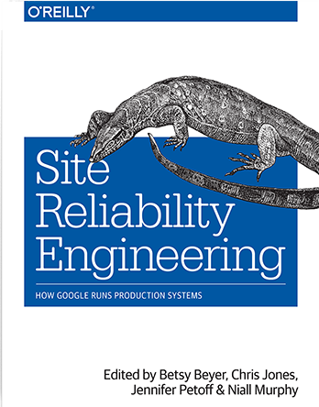
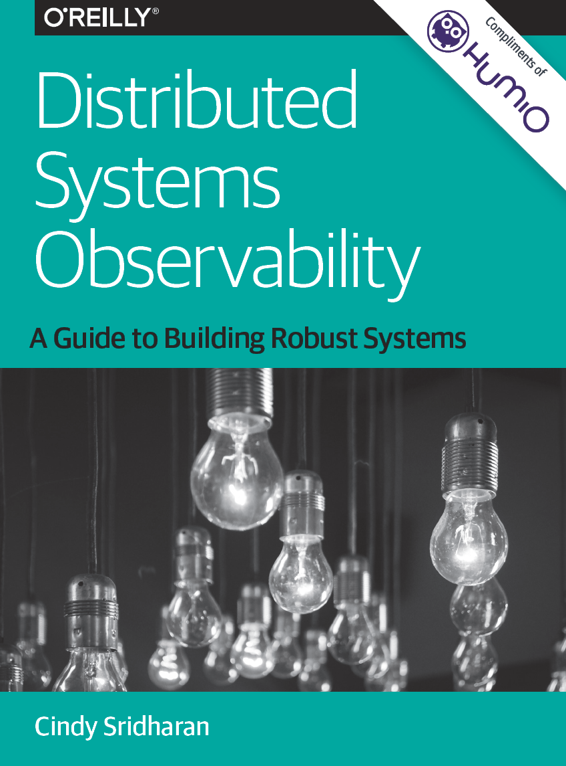
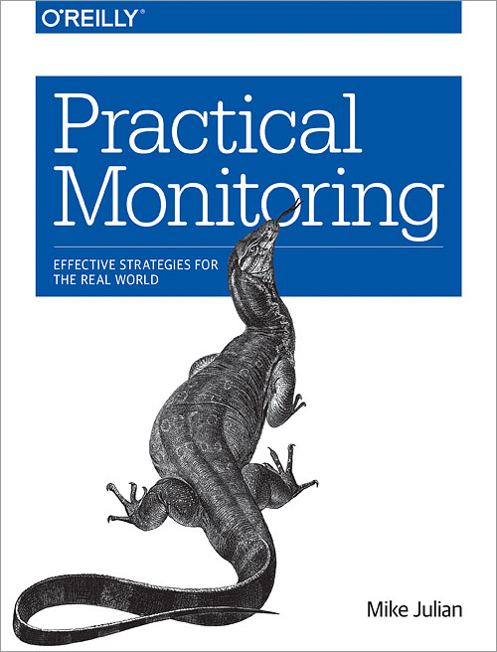
Resources

Slide 15

Thank You!
http://nikcodes.com/monitoring
Nik Molnar @nikmd23


Slide 16
Demo Setup info in Notes
Notes:
Dashboard (http://aka.ms/AMPMonitoring)
Add clock, set timezone – discard
Alerts
Look at alerts, show a break down in new preview
- Redis is a good example
Logging (contosoretail-it):
1. Show getting started screen & injestion number
2. Show queries
3. Pin last query to "Monitoring & Analytics" dashboard and refresh it
Usage?
Metrics (contosoretailweb):
1. Show live metrics, show main server
2. Increase traffic from CloudShop App
3. See the changes live
4. Switch over to the metrics preview.
5. Add metric for Server Requests, Sum and add City as the next dimension
Tracing (contosoretailweb):
1. Show App Map
2. Click edge with most errors
3. Investigate failures
4. Click 284 409 Response code
5. Click the suggested one
6. Click the error triangle
Debugger
Profiler

